Slide 1

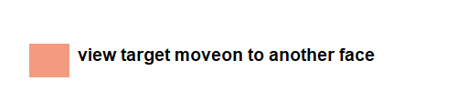
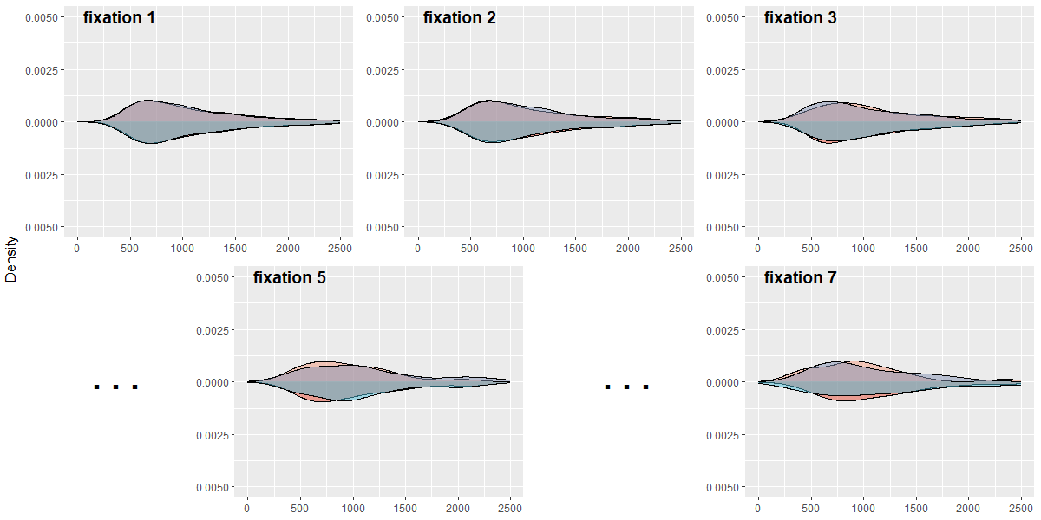
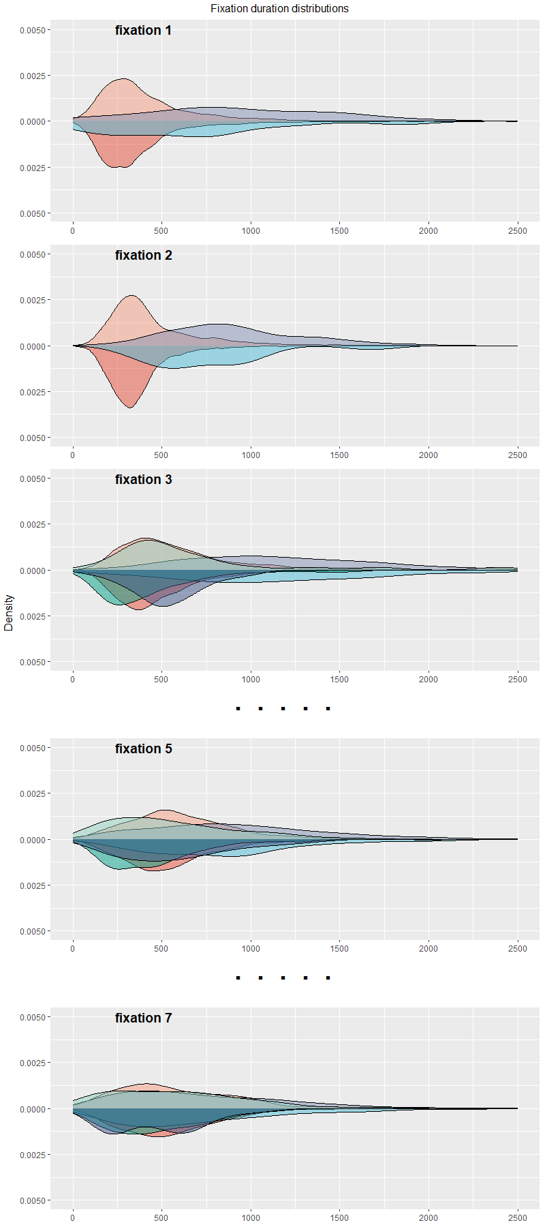


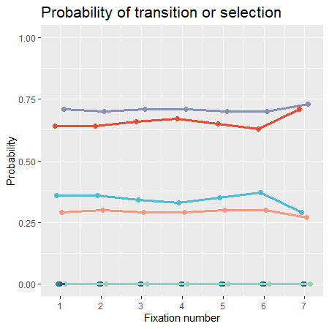
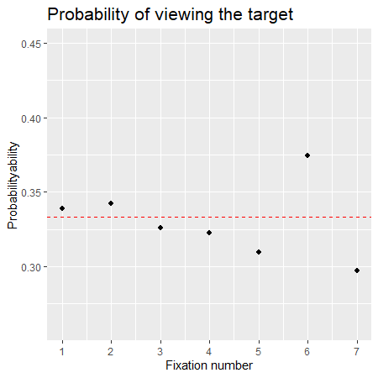



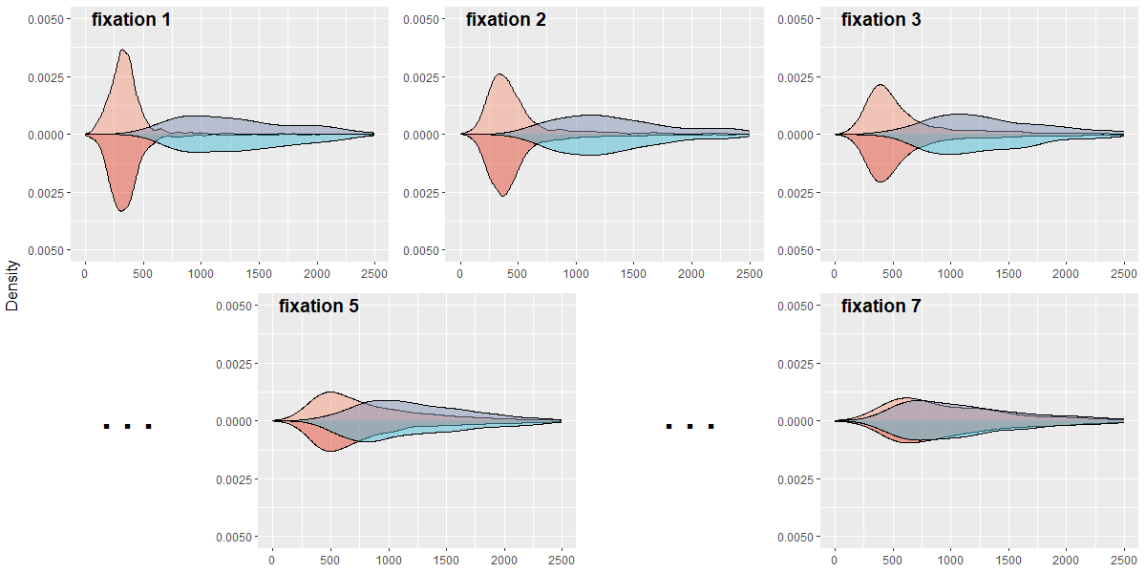


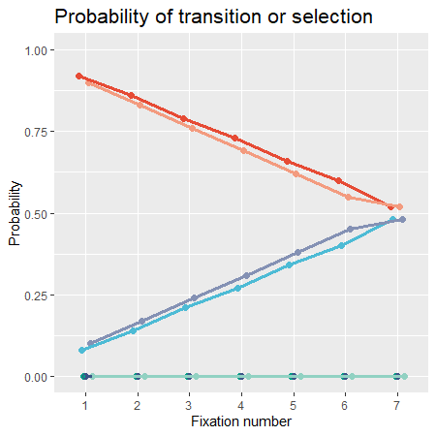
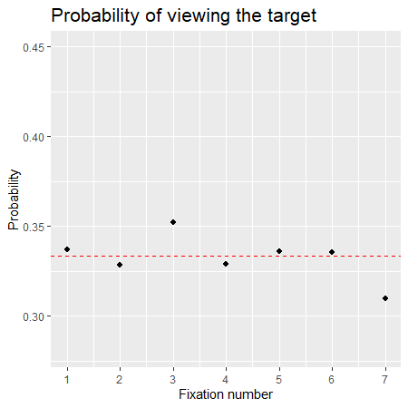


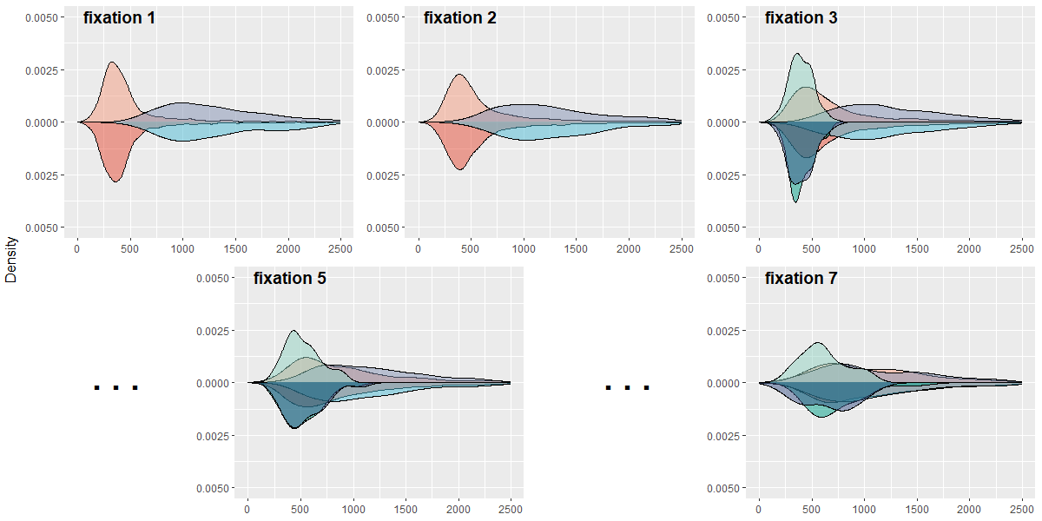
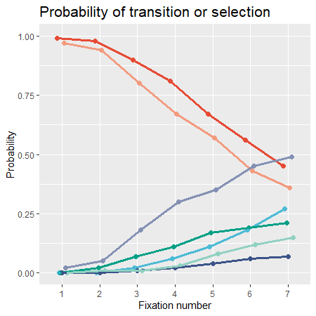
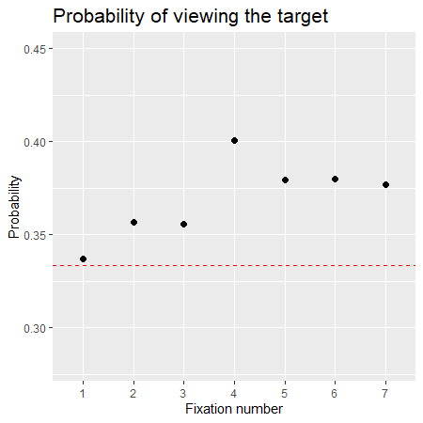
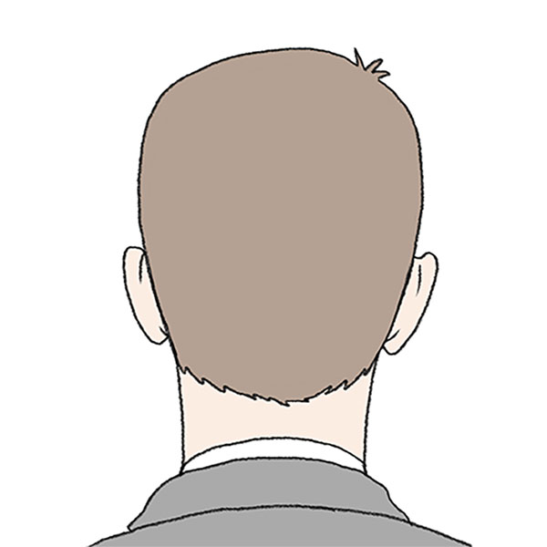
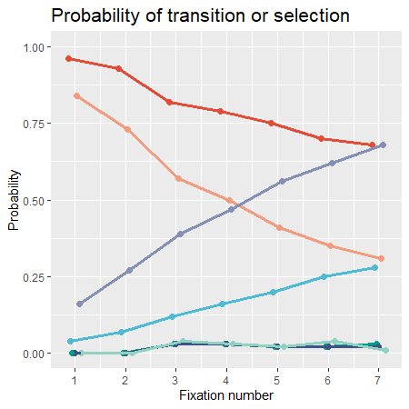
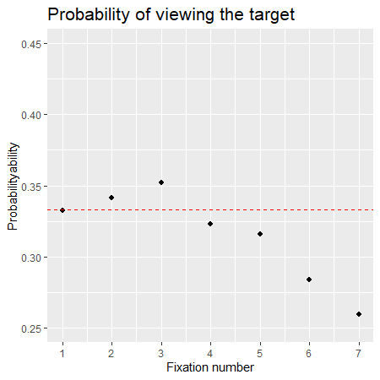
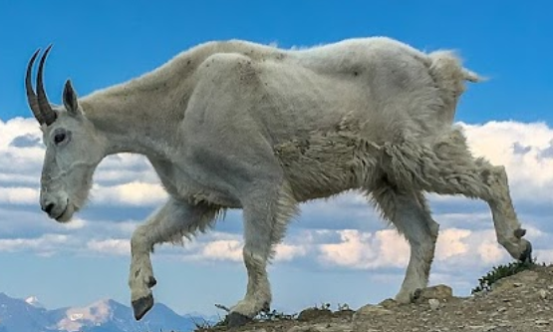
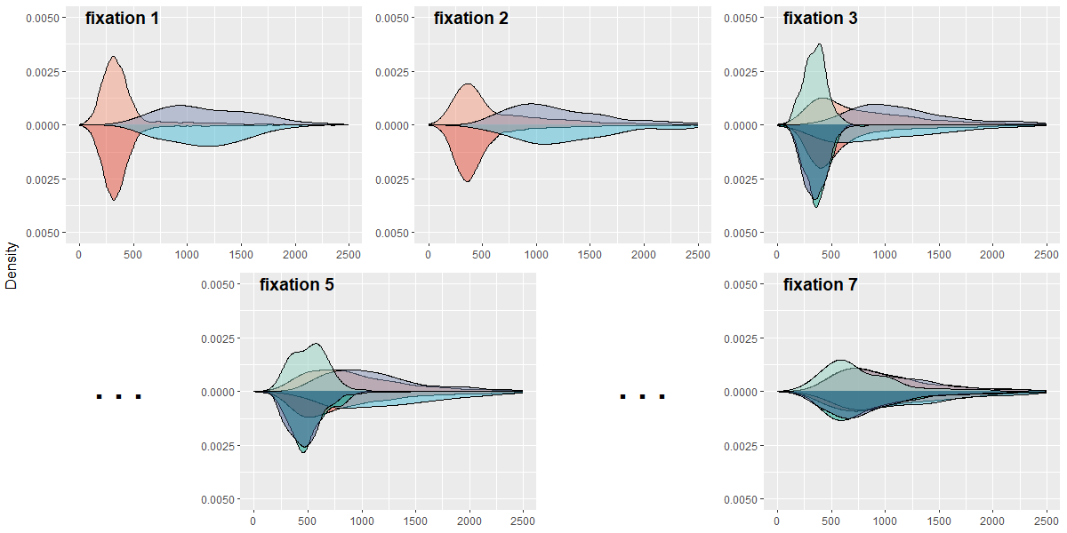
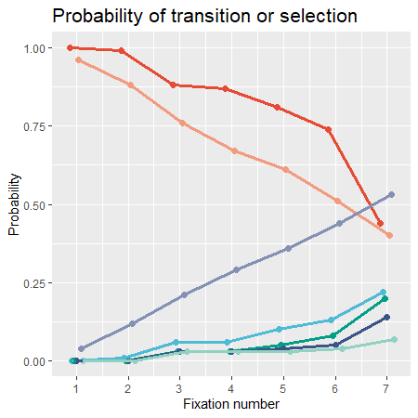
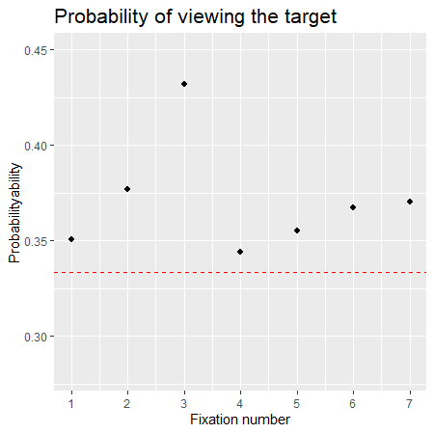
Models of Eye Movements during Forced-Choice Recognition
#6058
Runhan （Brad) Yang¹, Jonathon Whitlock^{1,2}, and Aaron S. Benjamin¹ ¹Department of Psychology, University of Illinois Urbana-Champaign
²Department of Psychology, Mississippi State University
Intro and Goals
People make eye movements among competing options when making forced-choice recognition decisions among faces.
We model this behavior with:
A random walk for each fixation that determines whether that face is endorsed or the decision-maker transitions to another face (cf. Ratcliff, 1978)
Competing policies for how to determine which face to look at next
We compare models of increasing complexity to 8 empirical benchmarks drawn from a recent study (Whitlock et al., 2024).
Results
Gaze-Duration Distribution Data
Models
Behaviors
Model 1: Base model
Random walk with unbiased starting point
Drift rate higher for target than for lure
Random transition among faces
Captures benchmarks 1, 2, and 3
target
lure
Model 2: Moving starting bias
Moving starting bias from conservative to liberal over fixations
Captures all benchmarks except 7, 8
Experiment Method
N = 115
forced-choice face recognition
one target and two lures
Model 3: Preference to revisit compelling faces
Keeps track of random walk for each previously viewed face and prefers to visit faces that yielded more positive evidence.
Captures all benchmarks except 8
target
lure
Behavioral Choices
lure
chance viewing probability
Empirical Benchmarks
Outcomes of the standard random walk process
• Benchmark 1: Gaze-duration distributions for each fixation are right skewed
• Benchmark 2: Endorsements are slower than decisions to transition to another face
• Benchmark 3: Endorsement probability is higher for targets than lures
Policies about the random walk
• Benchmark 4: Decision made on the Nth fixation
• Benchmark 5: Gaze-duration distributions converge to a homogenous form in later fixations
• Benchmark 6: Endorsement probability for currently fixated face increases with the number of fixations
Policies about transition
• Benchmark 7: Endorsement probability of a face that is not currently being fixated increases with the number of fixations
• Benchmark 8: Target is more likely to be revisited than lures
Model 4: Withhold selection
Model can withhold selection even when selection boundary is reached, especially in early fixations
Captures all benchmarks

